Slide 1
Software Engineering Modeling
Airline’s Tweet Sentiment Analysis
Name-Shrikant Patro
Registration No- 18MCB1009

Slide 2
Software Model : The Spiral Model
An evolutionary model that couples the iterative nature of prototyping with the controlled, systematic aspects of waterfall model.
Spiral model is often developed in a series of releases or versions.
Better for large projects
Each phase of spiral model is divided into four quadrants.

Slide 3
Software Model : The Spiral Model
1. Objectives determination and identify alternative solutions: Requirements are gathered from the customers and the objectives are identified, elaborated and analyzed at the start of every phase. Then alternative solutions possible for the phase are proposed in this quadrant.
2. Identify and resolve Risks: During the second quadrant all the possible solutions are evaluated to select the best possible solution. Then the risks associated with that solution is identified and the risks are resolved using the best possible strategy. At the end of this quadrant, Prototype is built for the best possible solution.
3. Develop next version of the Product: During the third quadrant, the identified features are developed and verified through testing. At the end of the third quadrant, the next version of the software is available.
4. Review and plan for the next Phase: In the fourth quadrant, the Customers evaluate the so far developed version of the software. In the end, planning for the next phase is started.

Slide 4
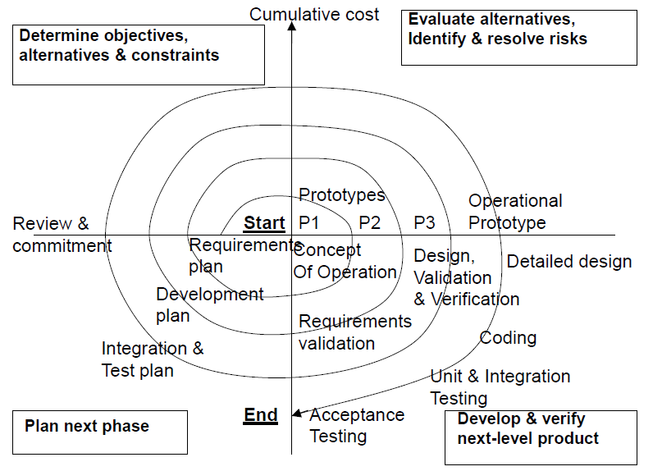
Software Model : The Spiral Model

Slide 5
Advantage of Spiral Model :
Realism: the model accurately reflects the iterative nature of software development on projects with unclear requirements
Flexible: incorporates the advantages of the waterfal and rapid prototyping methods
Comprehensive model decreases risk
Good project visibility.

Slide 6
Limitation of Spiral Model
Needs technical expertise in risk analysis to really work
Model is poorly understood by non-technical management, hence not so widely used
Complicated model, needs competent professional management. High administrative overhead.

Slide 7
Requirement Analysis
This phase is responsible for the requirement gathering and documentation.
Customer participation is expected throughout software development process
The key point obtained during meeting will be elaborated to frame final requirement list
Requirement will be prioritized before development phase
To achieve exact requirement :
Agenda of the meeting will be finalized
Meeting will be conducted.
Open ended and closed ended question will be asked.

Slide 8
Purpose of Software
The purpose of the document is to build an analytical software for sentiment analysis of the flight tweet by passengers, reservation and other support functionality.
This product will assist the flight management team to know the sentiment of the people travelling through flight and serve them better.
This document will cover complete requirement, Design, verification, validation and testing details.
This will classify the tweets mostly into three category Good, Bad, Neutral. This will help the flight management staff to know better their customer.
The business will perform better in near future by making appropriate suggestions analyzed by the software. Better business and marketing strategy can be developed using knowledge from this software.
Different ways to perform Analysis using Machine Learning and Deep Learning along with their pros and cons is mentioned in referenced document.

Slide 9
Software Feature
Login: User will be able to login into system. If user have no account. Then, System will ask user for Sign In followed by Sign In.
Enrollment: Customer can register them with more than one account, provided that sufficient details are mentioned.
Book Flights: The user can use the Book Flights function to purchase seats for an airplane flight.
Reserve Seats: The user can use the Reserve Seat function to reserve seats for an airplane flight.
Flight Status: This section shall allow the user – whether enrolled or not – to view flight information that matches input criteria.
Flight Schedules: This section of the system shall allow a user to query flight schedules based upon simple input criteria. The user will provide departure and arrival cities, and a departure/return date.

Slide 10
Software Feature
My Account: This section gives the user the power to view, save, edit or delete the information stored in his/her account. The user can check his/her accumulated points, look at the status of a flight that was booked,
Logout: The Logout section provides a way for the user to securely log out of the system.
Classification of Comment: This function is major functionality of the proposed product. It will classify the comment in test phase into Good, Bad and Neutral Comment. The proportion of this comment to analyze the overall performance of the Flight Management and services.

Slide 11
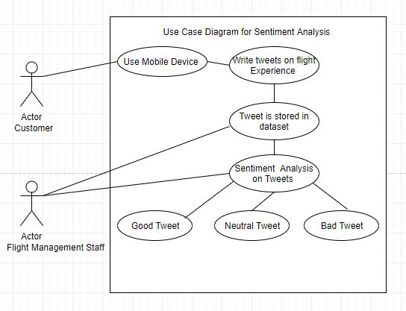
Use Case Diagram

Slide 12
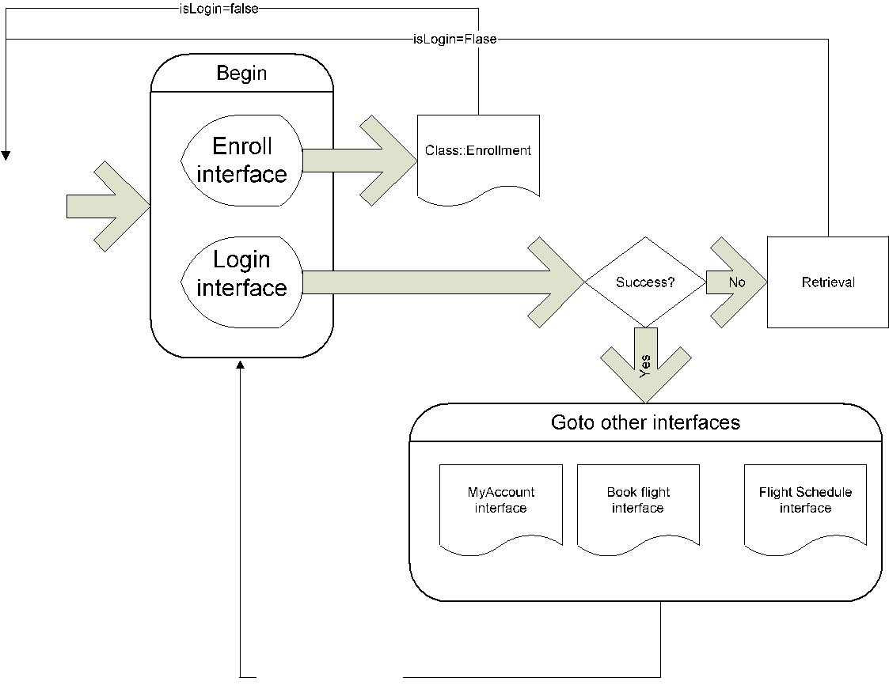
Use Case Diagram
Customer

Slide 13
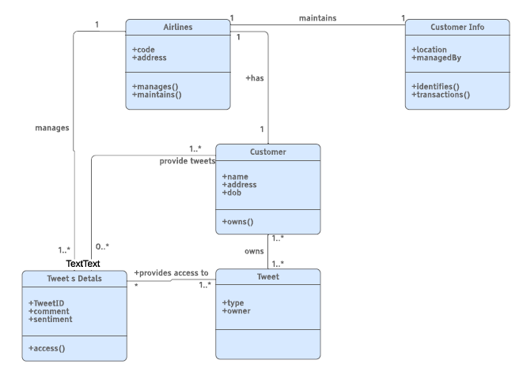
Class Diagram

Slide 14
Functional Testing
Sanity Testing: All the Major Vital functionality that include allow person to place tweet, storage of Tweet in Dataset and Tweet classification is tested.
Smoke Testing: This is first version of the software produced. So, Smoke Testing is performed once for version 1.0.
Regression Testing: It is thoroughly performed. Any change in code enhancement and fixing the bug is not affecting software.
Integration Testing: The module for validating the Customer Credential, allowing the person to place tweet, Storage of Tweet in Dataset and Tweet classification is tested.
Beta / Usability Testing: This is not performed yet.
System / End to End Testing: Complete System is verified once all the module is integrated in integration testing.

Slide 15
Black Box Testing: Equivalence Partitioning
Equivalence Partitioning: The Tweet length must not Exceed 280 Character. This 280 character contain Text, Tweet handle and Special Word.
 | Tweet Length |  |  |  | Accept Tweet Length from 1 character to 280 character
 |  | Equivalance Class Partition
 |  | Invalid | Valid | Invalid
 |  | <=0 | 1-280 | >280

Slide 16
Black Box Testing: Decision Table
Decision Table/ Cause-Effect
Decision Table | Accept User | Reject User | Accept user Tweet | Reject User Tweet
Conditions
Valid User Credential | T | F | F | F
Invalid User Credential | F | T | F | T
Valid Tweet Length | T | F | T | F
Invalid Tweet Length | T | F | F | T

Slide 17
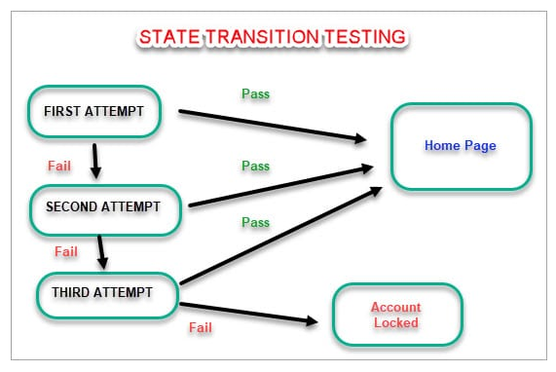
Black Box Testing: State Transition Testing

Slide 18
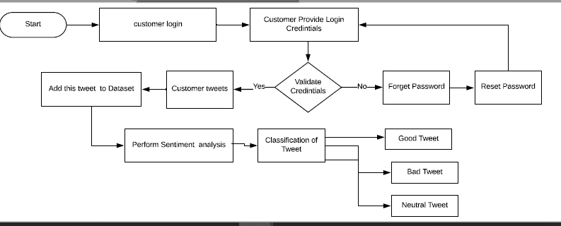
Flow Chart

Slide 19
Change Management
Corrective changes:
The changes that occur day to day in the application used by the citizens,
It is the change that happens during the development process,
The glitches that happen are modified in the application for a long term use to keep the application work for long time.
Adaptive changes:
The changes made in the application for one service should be able to adapt in other services.
If there is an update in the tax document verification process then all other related services have to be adapted.
Preventive Changes:
This is make to ensure that the performance of the application used by the citizen’s doesn’t downgrade.
The redundant modules are added to make sure that this application is strong defence against potential failures.

Slide 20
Change Management
The team of Change control board is necessary in the software team for making changes in the application when citizen’s need arises.
Initially a change request is raised for a particular service( such as license registration),
This CR will include the user’s expectation of the service to be added or the bug to fixed for a particular service,
Then it’s forwarded to the Change Control Board(CCB),
The CCB in the software team will now discuss the nature of the change (whether it’s for a new service or a bug to be fixed for the citizen’s application) and assign priority,
Based on the assigned priority the changes would take place.

Slide 21
Thank you

